Slide 1

Real-World Deployment of ML in Production Systems
Author: Hussain Abbas, MSc
© 2021 Stats AI LLC
All Rights Reserved

Slide 2
Why Deploy ML Models?
ML model Deployment enables firms to create new services!
The interaction between the user and the ML model is the service
Recommender Systems: Netflix Recommendation Algorithm
Financial Services: Algorithmic Portfolio Selection
Rideshare: Uber arrival time prediction
Deployed ML models enable firms to:
Acquire new customers
Retain existing customers
Grow revenues
Cut costs
Gain market share
Gain competitive advantage
Stay relevant

Slide 3
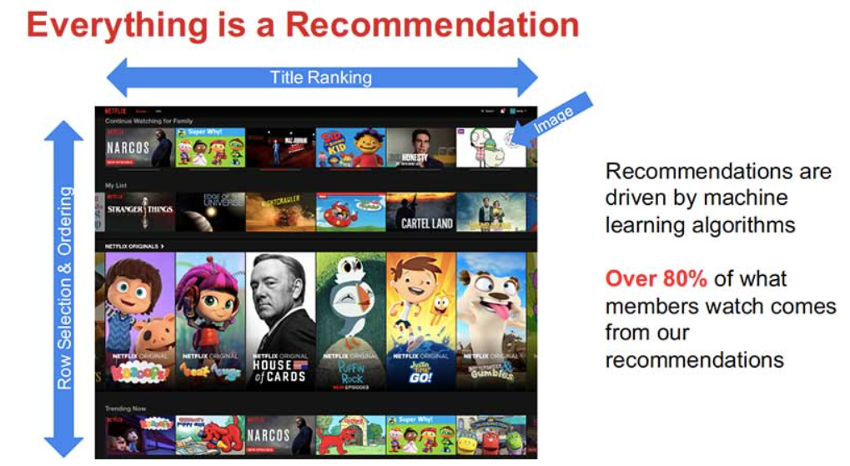

Recommender Systems

Slide 4
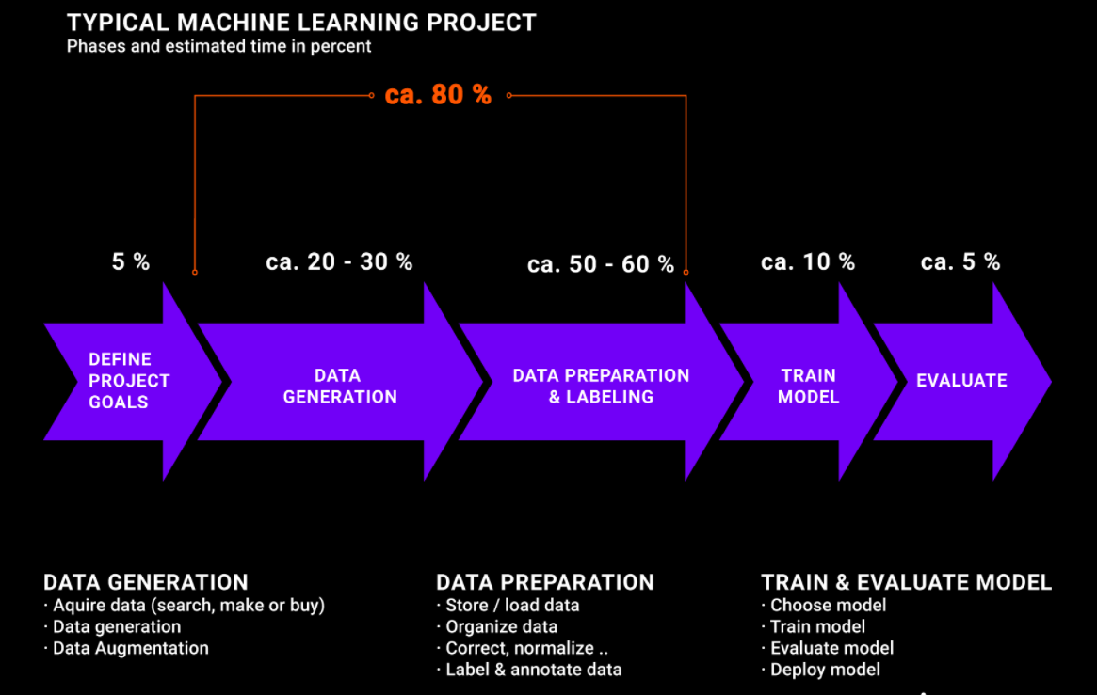
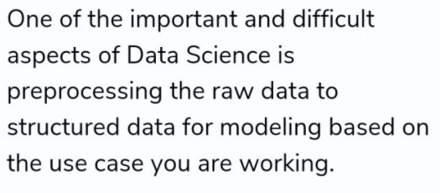
You are here!

Slide 5
Model Deployment
Once an ML model is developed, it needs to be deployed as a REST API so users can interact with it
How a ML REST API works under the hood:
The trained ML model is pickled
JSON payload delivers feature data via a POST request
Various transformations are applied to the JSON payload before it enters the model
The model takes in the input and an output prediction is generated
The API returns the prediction from the model in JSON
The JSON output is presented to the user either directly or indirectly
Direct: Streamlit, Gradio, GUI, etc.
Indirect: API output is an input into an Enterprise application
The two types of deployment
Batch
Take in a set of inputs at a point in time, and generate predictions
Real-time
Generate predictions on the fly as requested

Slide 6
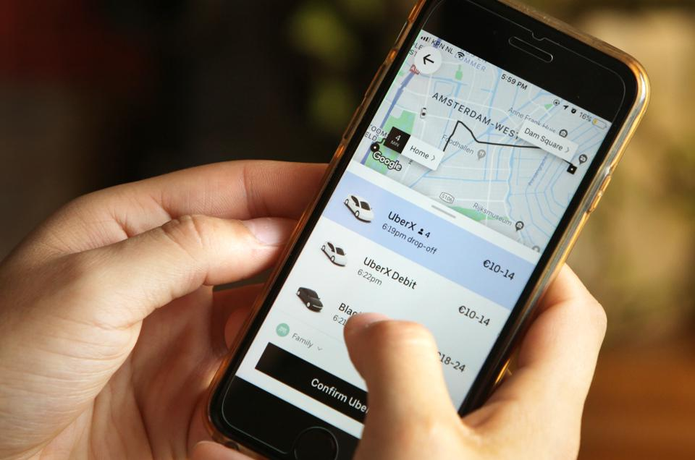
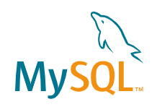
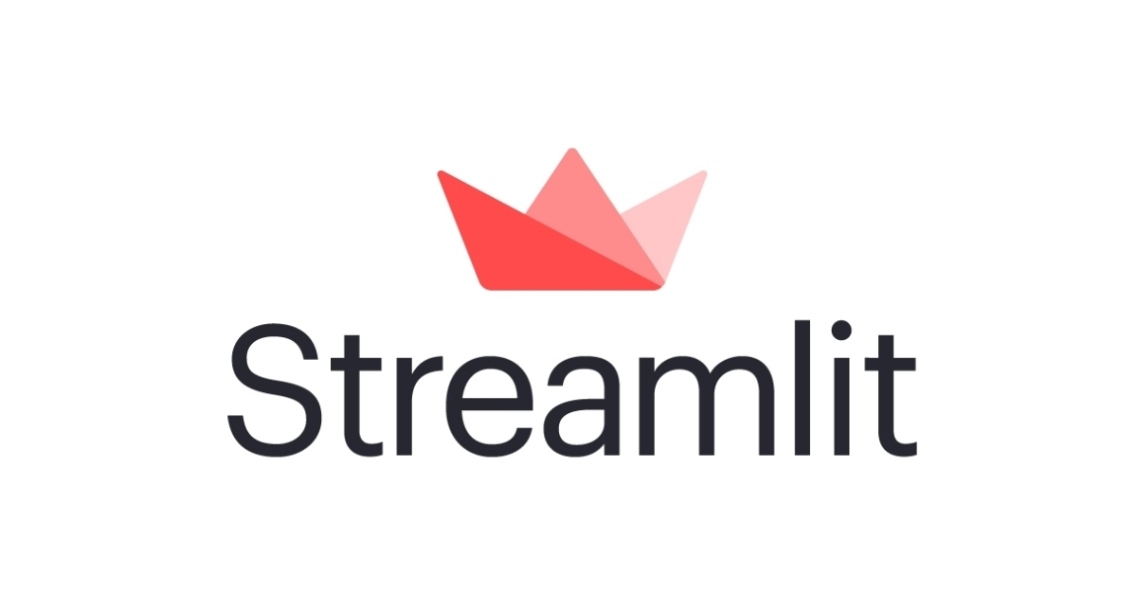
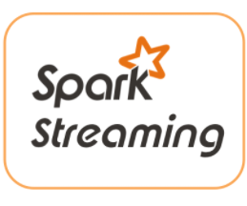

Model Deployment
Where does the JSON payload that triggers the POST Request come from?
A database
User interaction
Manual user entry
User Location
Streaming data
All the above combined!

Slide 7
Model Deployment
Generally, external customer facing services require a level of engineering effort magnitudes larger than internal services
As internal services become more complex, they start to approximate external services
Thus, what is needed are streamlined deployment systems that enable rapid iteration that can scale with complexity and demand … hence the Cloud

Slide 8
Deployment in the Cloud

Slide 9
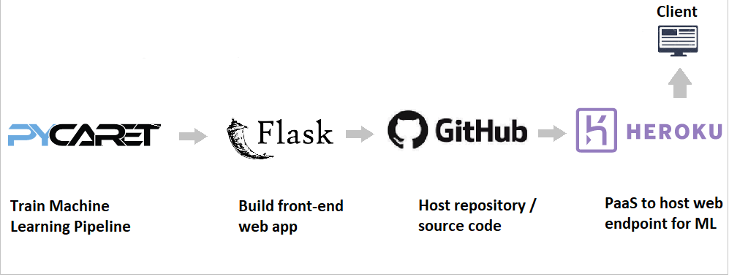
Example Workflow: Level I
https://towardsdatascience.com/build-and-deploy-your-first-machine-learning-web-app-e020db344a99
Pycaret: Trains ML model and pickles saved model
HTML: Website the user interacts with (in this case a simple web form)
Flask: Backend web framework which powers the REST API and HTML front-end
GitHub: Where all the code necessary to create and deploy the model lives
Heroku: PAAS (Platform as a Service) used to quickly develop and host apps

Slide 10
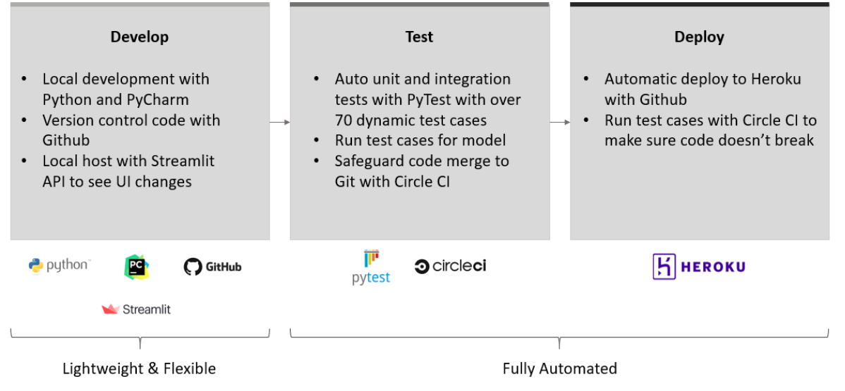
Example Workflow: Level II
https://www.kdnuggets.com/2020/02/machine-learning-challenge-build-deploy-app-streamlit-devops.html
Unit testing: ensures that an individual module behaves as expected
Integration testing: ensure that a collection of modules interoperate as expected
Circle CI: gate check code merge on GitHub as well as deployment of ML models to production

Slide 11
Docker & Kubernetes
Container-based applications can be moved easily from on-prem systems to cloud environments or from developers’ laptops to servers
Dockerfile
a text file with the instructions to build a Docker image
specifies the OS, the programming languages, environmental variables, file locations, network ports, and other components the application needs
Docker Image:
is a portable file containing the actual files. Thus, it is usually a large file
can be stacked. i.e., you can take an image someone else created and build upon it
Docker Container: an instance of the docker image, i.e., the program that you want to run
Container Registry: DockerHub, Azure Container Registry Amazon ECR, Google Container Registry
Where we upload Docker images we create and download docker images created by others
Kubernetes: Enables container orchestration, i.e, the ability for containers to talk to each other
We can create multiple containers from a single image on a single host OS
Kubernetes is how we enable those containers to talk to each other across multiple host OS
Thus, scaling up an application simply becomes spinning up more machines in a Kubernetes cluster

Slide 12
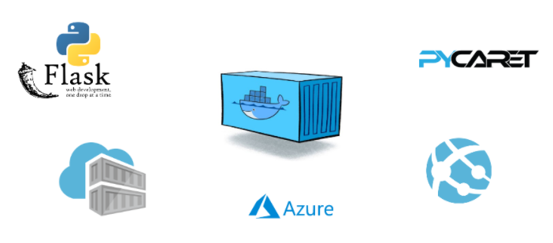
Example Workflow: Level III
Containerize and Deploy Machine Learning Pipeline as an Azure Web App
https://towardsdatascience.com/deploy-machine-learning-pipeline-on-cloud-using-docker-container-bec64458dc01
Docker Image: a file consisting of all the dependencies needed to run our application
Amazon Container Registry (ACR): Where we register the Docker Image we created
Azure Web Apps (PAAS): Runs the Docker Container that we instantiated from the Docker Image

Slide 13
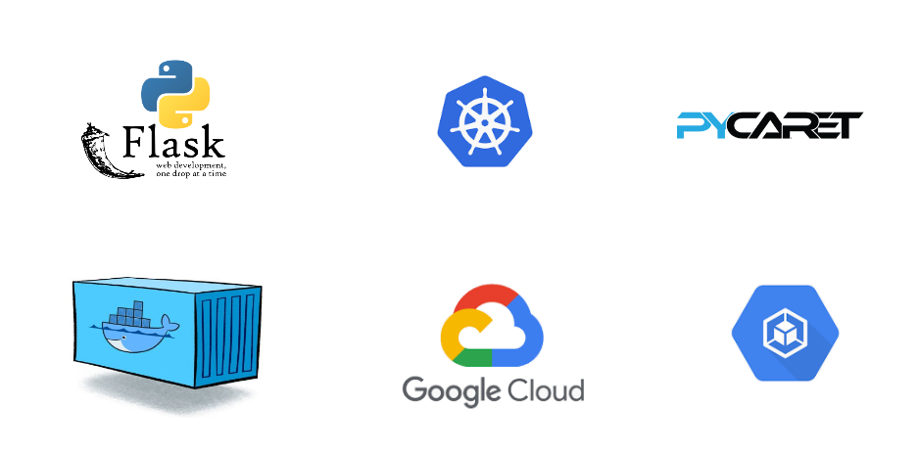
Example Workflow: Level III
Containerize and Deploy Machine Learning Pipeline on Google Kubernetes Engine
https://towardsdatascience.com/deploy-machine-learning-model-on-google-kubernetes-engine-94daac85108b
Docker Image: a file consisting of all the dependencies needed to run our application
Google Container Registry (ACR): Where we register the Docker Image we created
Google Kubernetes Engine: Runs the Docker Container across a cluster which can autoscale

Slide 14
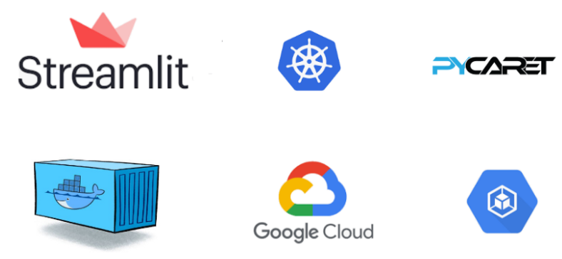
Example Workflow: Level III
Containerize and Deploy a Streamlit app on Google Kubernetes Engine
https://towardsdatascience.com/deploy-machine-learning-app-built-using-streamlit-and-pycaret-on-google-kubernetes-engine-fd7e393d99cb
Note: Before we used Flask + HTML to deploy our GUI. Here instead Streamlit is used to do the same thing.
Docker Image: a file consisting of all the dependencies needed to run our application
Google Container Registry (ACR): Where we register the Docker Image we created
Google Kubernetes Engine: Runs the Docker Container across a cluster which can autoscale

Slide 15
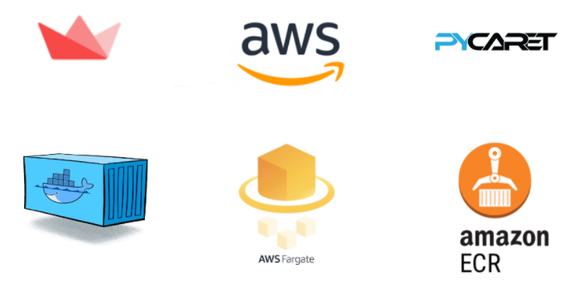
Example Workflow: Level III
Containerize and Deploy a Streamlit app on AWS Fargate
https://towardsdatascience.com/deploy-pycaret-and-streamlit-app-using-aws-fargate-serverless-infrastructure-8b7d7c0584c2
AWS Fargate/Google Cloud Run are serverless PAAS (benefits of development w/o resource management)
Docker Image: a file consisting of all the dependencies needed to run our application
AWS Elastic Container Registry (EACR): Where we register the Docker Image we created
AWS Fargate: Auto manages the resources on ECS or EKS to scale the Docker Container

Slide 16
The Rise of Feature Stores

Slide 17
Feature Stores
Are basically databases for features
By tightly coupling feature generation to data generating process, the Feature Store eliminates the possibility of finding features found in R&D that aren’t possible to implement in production
Eliminates Data Leakage:
Data is uploaded nightly.
The model developed in R&D finds that intraday data is best.
The problem is that that intraday data only exists after the fact.
Thus, only the prior night’s data would be available for the production system
Thus, the feature store enables the data scientist developing the R&D system to “know” that intraday data would not be available at the time of inference
Bottom line: The Feature stores value prop is its ability to serve as a single source of truth for development of both ML models and inference on fresh input values

Slide 18
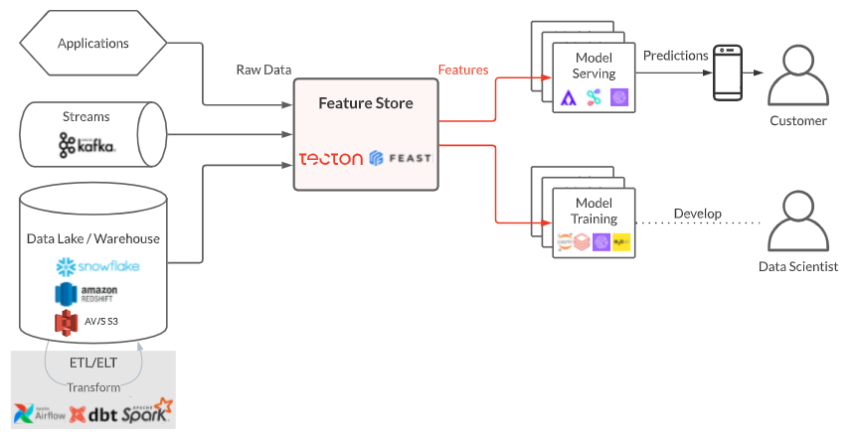

Slide 19
Feature Stores
Introduce economies of scale:
Features discovered for one model are often useful in other models
We can group features by the tasks they are used in
regression tasks, classification tasks, anomaly detection tasks
When a newly created feature is registered in a feature store, it becomes available for immediate reuse by every other model across the organization
This reduces duplication of data engineering efforts and allows new ML projects to bootstrap with a library of curated production-ready features

Slide 20
